Slide 1
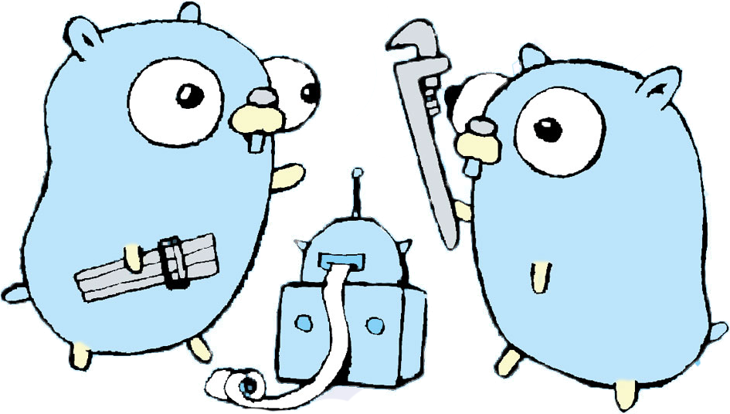
Debuggers
How debuggers work from a low level, and how to use one

Slide 2

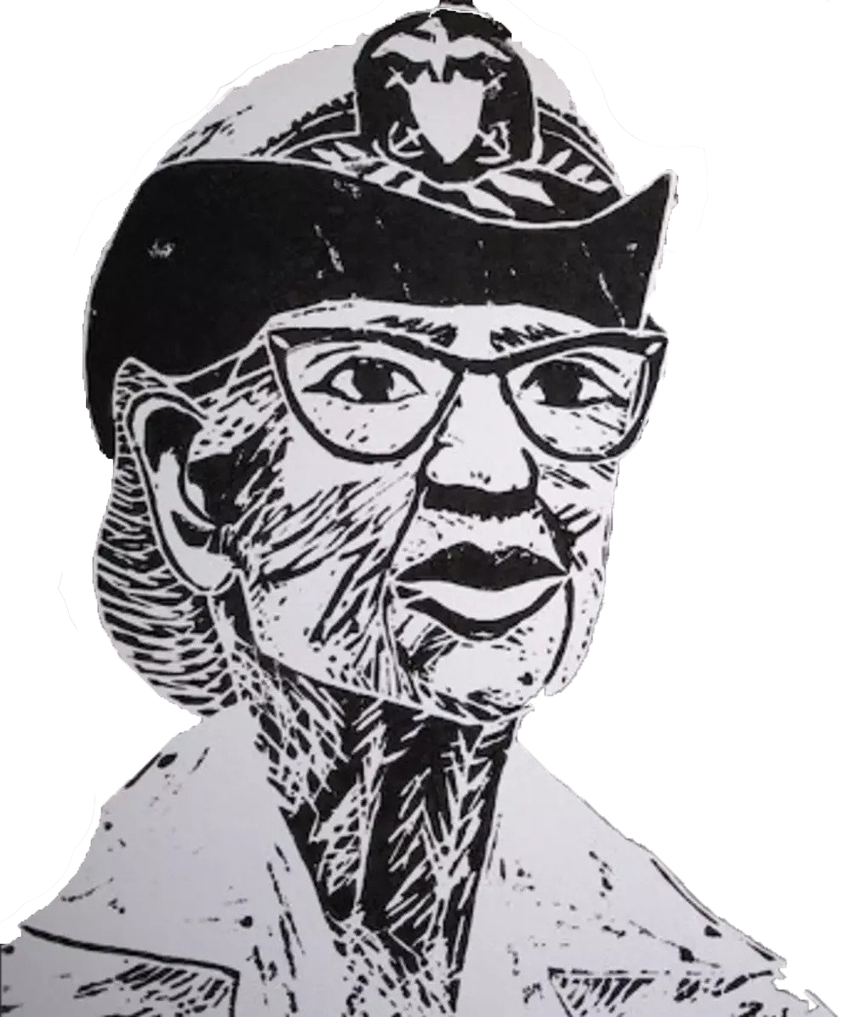
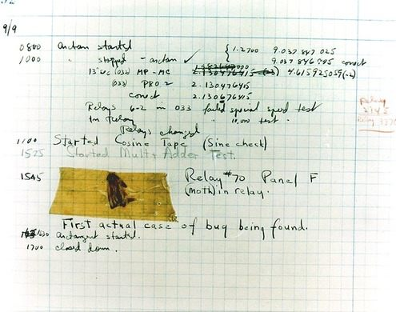
Debugging vs. Debuggers
Debugging is “the process of finding and resolving defects or problems within a computer program that prevent correct operation of computer software or a system”. The origin of this term comes from when Grace Hopper was figuring out why a relay wasn’t working in the Harvard Mark 2 and came to find a literal bug in the machine. She is also attributed for inventing the compiler.

Slide 3

Debugging vs. Debuggers
—Boris Beizer
A Debugger is “a computer program used to test and debug other programs. The main use of a debugger is to run the target program under controlled conditions that permit the programmer to track its operations in progress and monitor changes in computer resources that may indicate malfunctioning code.”. Most IDEs, such as PyCharm, have debuggers as part of their set of tools. Debuggers can also be found in your browser (e.g. React developer tools), as CLI tools or flags (e.g. node inspect), and as part of a language’s standard library (e.g. pdb).
“Testing proves a programmers failure, Debugging is the programmer’s vindication.”

Slide 4


Cooool, so how do debuggers work?

Slide 5


System Calls
programmatic way for computer programs to request a service from the kernel of the operating system.This could be for operations hardware related (Accessing data from disk), creation and execution of new processes, communication with integral kernel services such as process scheduling, and much more. Important system calls for debuggers are: ptrace, fork and execve.
01
02
Returns from system call
√
04
User Process
Executing
Gets system call
User Mode
Kernel Mode
Execute System Call
03

Slide 6
Signals
Limited form of inter-process communication, similar to an interrupt, but only mediated by the OS kernel rather than the process and the kernel. Signals are an asynchronous notification sent to a process or to a specific thread within the same process in order to notify it of an event that occurred.
A few examples of signals
SIGTERM - Software termination signal
SIGKILL - If a process get this signal, it must quit immediately and will not perform any clean-up operations
SIGINT - Issued if the user sends an interrupt signal
SIGTRAP - Sent to a process when an exception (or trap) occurs: a condition that a debugger has requested to be informed of -- for example, when a particular function is executed, or when a particular variable changes value.

Slide 7
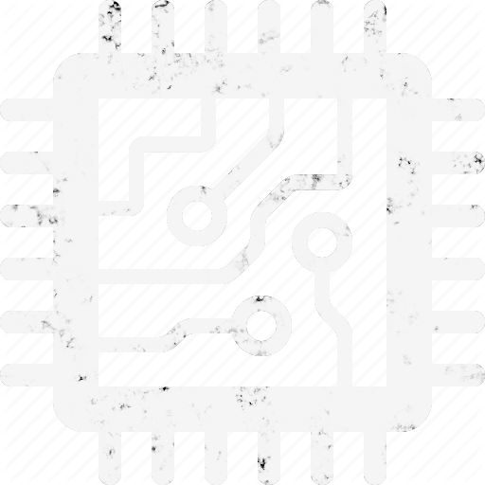
Ptrace, Fork and Execve
Ptrace (process trace) is a system call primarily used to implement breakpoint debugging and system call tracing. Ptrace provides a means by which one process (the tracer) may observe and control the execution of another process (the tracee), and examine/change the tracee’s memory and registers.
#include <sys/ptrace.h>
long ptrace(enum __ptrace_request request, pid_t pid,
void *addr, void *data);
Tracer - Debugger - pid 1000
Tracee - child process - pid 1010
Execve - syscall executes the program referred to by its pathname argument. This replaces the process, currently run by the calling process, with a new program with newly initialized stack heap and data segments. Each execve system call will cause a SIGTRAP to be delivered to the tracee. Any signal (except SIGKILL) delivered to this process, causes it to stop and it’s parent to be notified via wait() . All subsequent calls to exec() by this process will cause a SIGTRAP to be sent to it, giving the parent a chance to gain control before the new program begins execution
User Mode
Kernel Mode
Fork - Process duplicates itself into new process referred to as the child process
PTRACE_TRACEME - ptrace syscall made w/ ptrace_traceme as request, which indicates that this process is to be traced by its parent

Slide 8
Options the parent process has to continue
PTRACE_CONT - You typically see this when you aren’t stepping over lines of code, and choose to just continue forever until the end of the program, or until there is another breakpoint.
PTRACE_SYSCALL - The tracee stops before a system call is entered and also before a system call returns to userspace.
PTRACE_SINGLESTEP - Arguably the most common syscall used by developers during debugging. The tracee executes the next instruction, but stops immediately after.

Slide 9
How do debuggers know about state?!
In debuggers, while stepping through your code, you can see the state of your variables as you go. Otherwise, debuggers wouldn’t be very helpful at all. The state of a process is mostly captured by its registers. The way that debuggers know and present program state to you is by using a few special requests offered through the ptrace system call that get or modify those registers in the CPU.
PTRACE_GETREGS - This ptrace request will give the registers’ state as it was when a tracee was stopped.
PTRACE_SETREGS - If the tracer has the values of registers from a previous call to PTRACE_GETREGS, it can modify the values in that structure and set the registers to the new values via this request.
PTRACE_PEEKUSER / PTRACE_POKEUSER - Allows reading from the tracee’s USER area, which holds the registers and other useful information. This can be used to modify a single register, without the more heavyweight requests PTRACE_(GET, SET)REGS

Slide 10
Debugger methods

